Slide 1
Ride Austin Analysis
Team
Andrew Scott
Brandon Leal
Aritra Ghosh
Alex Garfias

Slide 2

Data Source
We came up with an idea of plotting rideshare data for the City of Austin, TX; we found a data set which we think provides great information that can be somehow easily analyzed and plotted with either leaflet, Java and/or D3 among other coding methods.
The source:
https://data.world/andytryba/rideaustin

Slide 3
Austin Ride Share Analysis
Andrew -Analyzing ride share data to show a Leaflet heat map of ride departures within Austin Texas, hoping to identify popular areas of Austin.
Alex –Will analyze the ride share data driver ratings, very likely will use D3 to create an interactive graph.
Aritra –
Brandon -

Slide 4
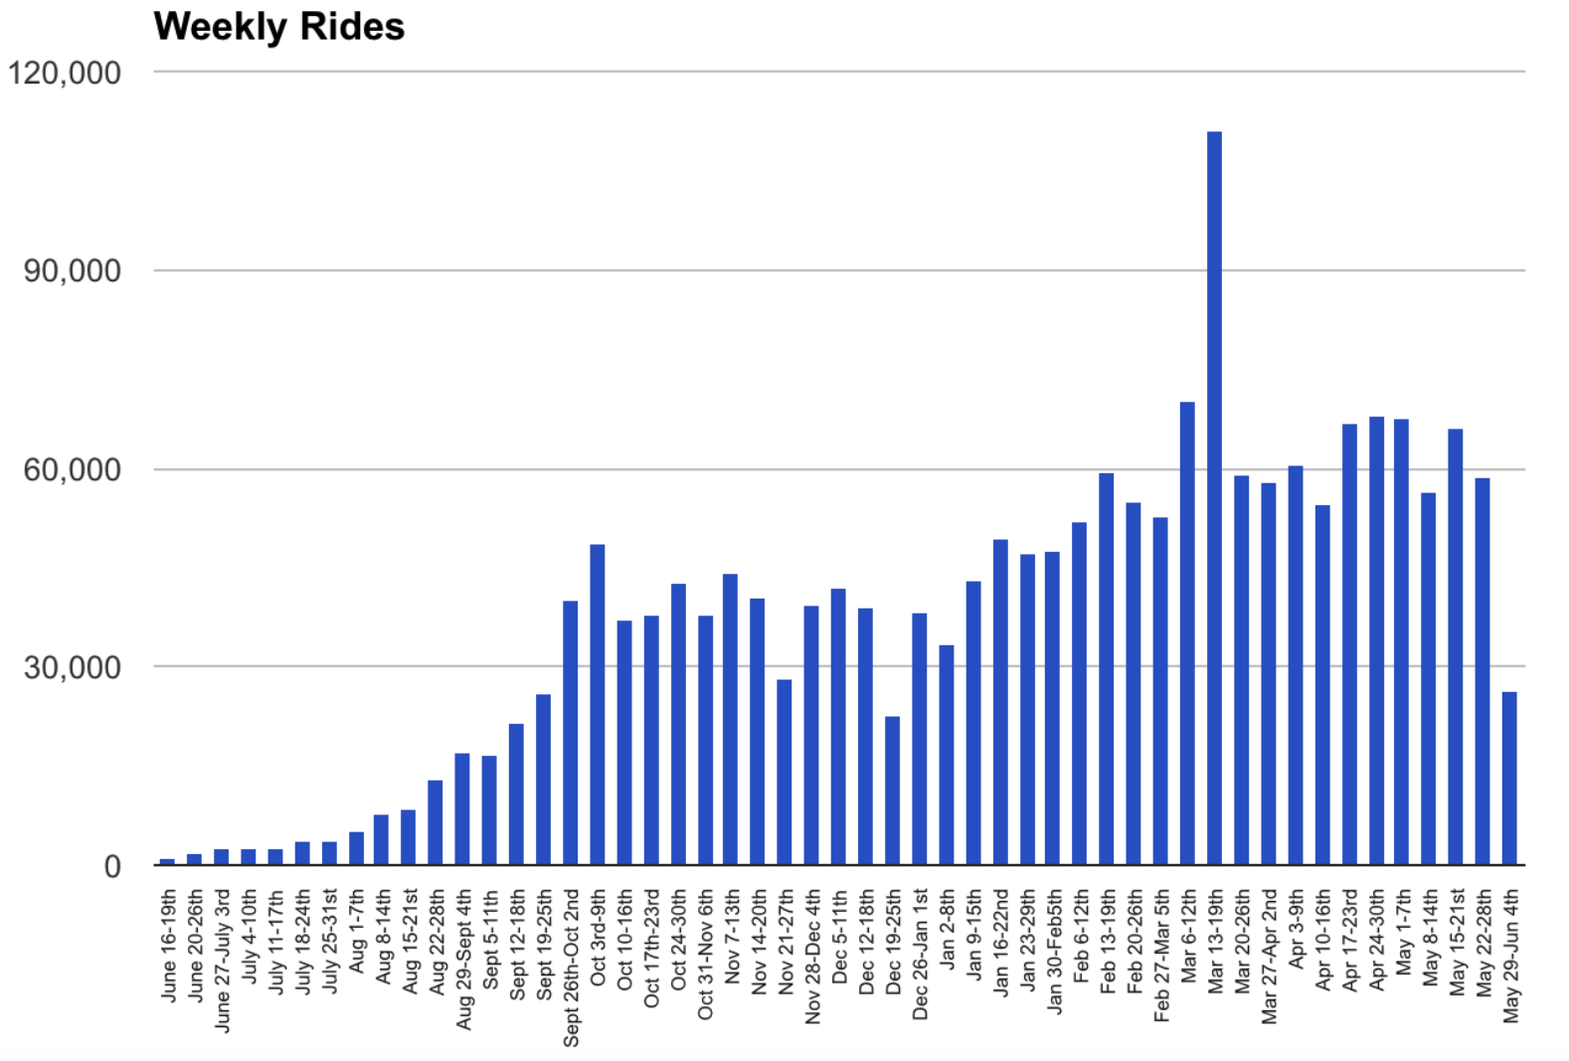
Project analysis slide 3
Weekly Rides

Slide 5
Project analysis slide 4
Most Popular Vehicles

Slide 6
Project analysis slide 5
Driver Rating

Slide 7
Project analysis slide 6
Number of Rides per Auto Make

Slide 8
Thank You

